Slide 1

Automation Testing of an E-commerce website
TEAM MEMBERS:
GOKULKANNAN MUTHUVEL - 2630900
SOWMIYA P - 2630904

Slide 2
AGENDA
PROJECT DESCRIPTION
TESTING METHODOLOGIES
TOOLS AND TECHNOLOGIES USED
SELENIUM
CUCUMBER
PLAYWRIGHT
JMETER
AUTOMATION TEST REPORTS

Slide 3
PROJECT DESCRIPTION
OBJECTIVE
Ensure the website (https://demowebshop.tricentis.com) functions correctly, reliably, and securely.
Validate the accuracy of various functionalities, including:
User interactions
Shopping cart operations
Checkout process
Ensure seamless API integration.

Slide 4
Testing Methodologies
Manual Testing: Involves human testers executing test cases without the use of automation tools.
Automated Testing: Uses software tools to execute pre-scripted tests on the application.
Integration: Combining both methodologies to ensure comprehensive test coverage.

Slide 5
Tools and Technologies Used
Selenium : Automated functional testing.
Cucumber: Behavior-driven development (BDD).
Playwright: Cross-browser end-to-end testing.
JMeter: Load and performance testing.
Excel: Manual test case documentation.

Slide 6
SELENIUM WEBDRIVER FOR TESTING
Selenium WebDriver was used for automating web application testing, facilitating cross-browser testing and regression testing.
It ensured the website functions correctly on different browsers such as Chrome, Firefox, Safari, and Edge.
Automated test scripts covered various user scenarios, including form submissions, navigation, and data validation.

Slide 7
CUCUMBER FOR BEHAVIOUR-DRIVEN DEVELOPMENT (BDD)
Cucumber was employed for Behavior-Driven Development (BDD), allowing the creation of test scenarios in plain language.
This approach enhanced collaboration between technical and non-technical stakeholders by making test cases more understandable and accessible.
Test scenarios were written in Gherkin syntax, describing the expected behavior of the application in a given context.

Slide 8
PLAYWRIGHT FOR CROSS-BROWSER END-TO-END TESTING
Playwright was utilized for end-to-end testing across multiple browsers, ensuring the website's functionality and performance were consistent across different browser environments.
Playwright's capabilities allowed for testing complex user interactions, such as drag-and-drop, file uploads, and dynamic content loading.

Slide 9
JMETER FOR LOAD AND PERFORMANCE TESTING
JMeter was used to simulate load and measure the performance of the website under various conditions.
It helped identify bottlenecks and optimize the application's performance by simulating multiple users accessing the website simultaneously.
Load testing scenarios included stress testing, spike testing, and endurance testing to evaluate the website's stability and responsiveness.

Slide 10
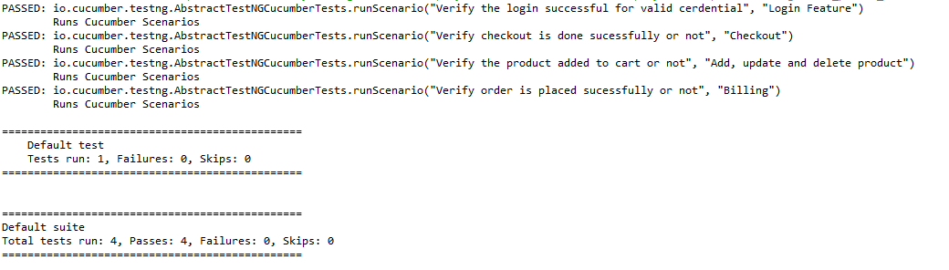
AUTOMATION TEST REPORTS
SELENIUM, CUCUMBER AND PLAYWRIGHT FOR TESTING
Fig. Console output 1

Slide 11
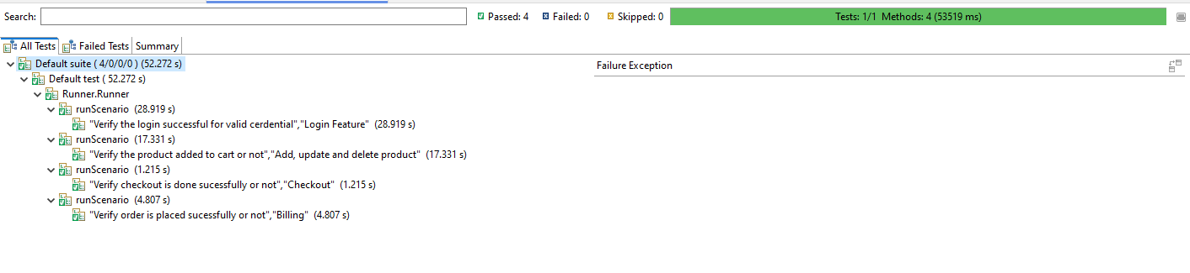
AUTOMATION TEST REPORTS
SELENIUM AND CUCUMBER FOR TESTING
Fig. Console output 2

Slide 12
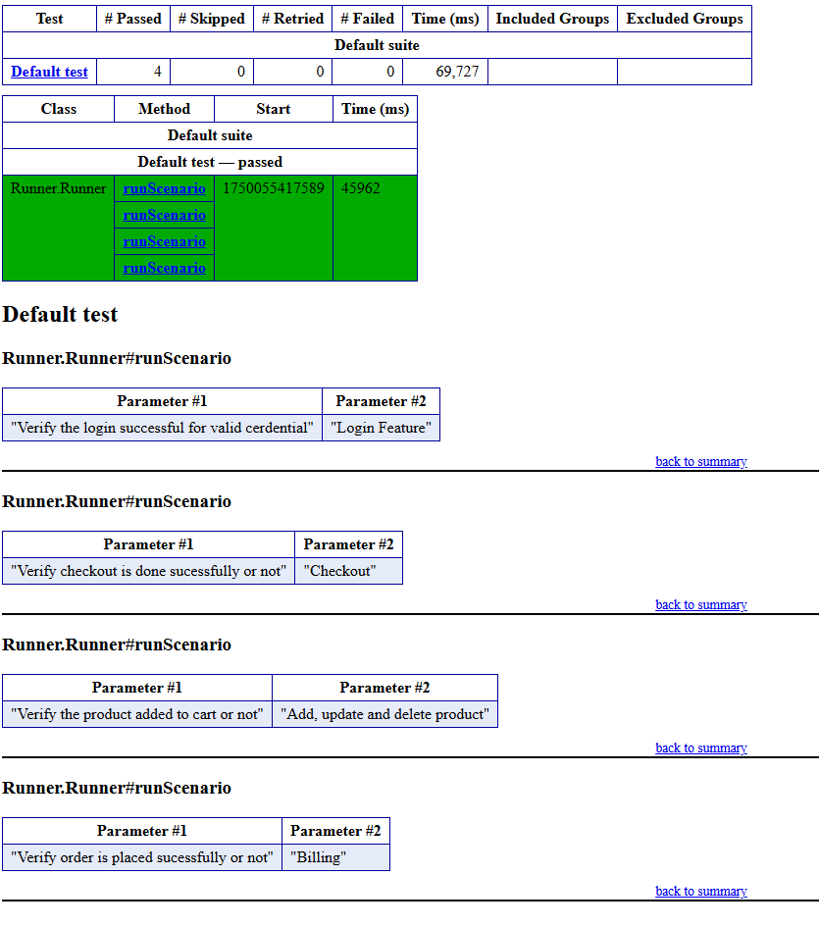
AUTOMATION TEST REPORTS
SELENIUM AND CUCUMBER FOR TESTING
Fig. TestNG (HTML report)

Slide 13
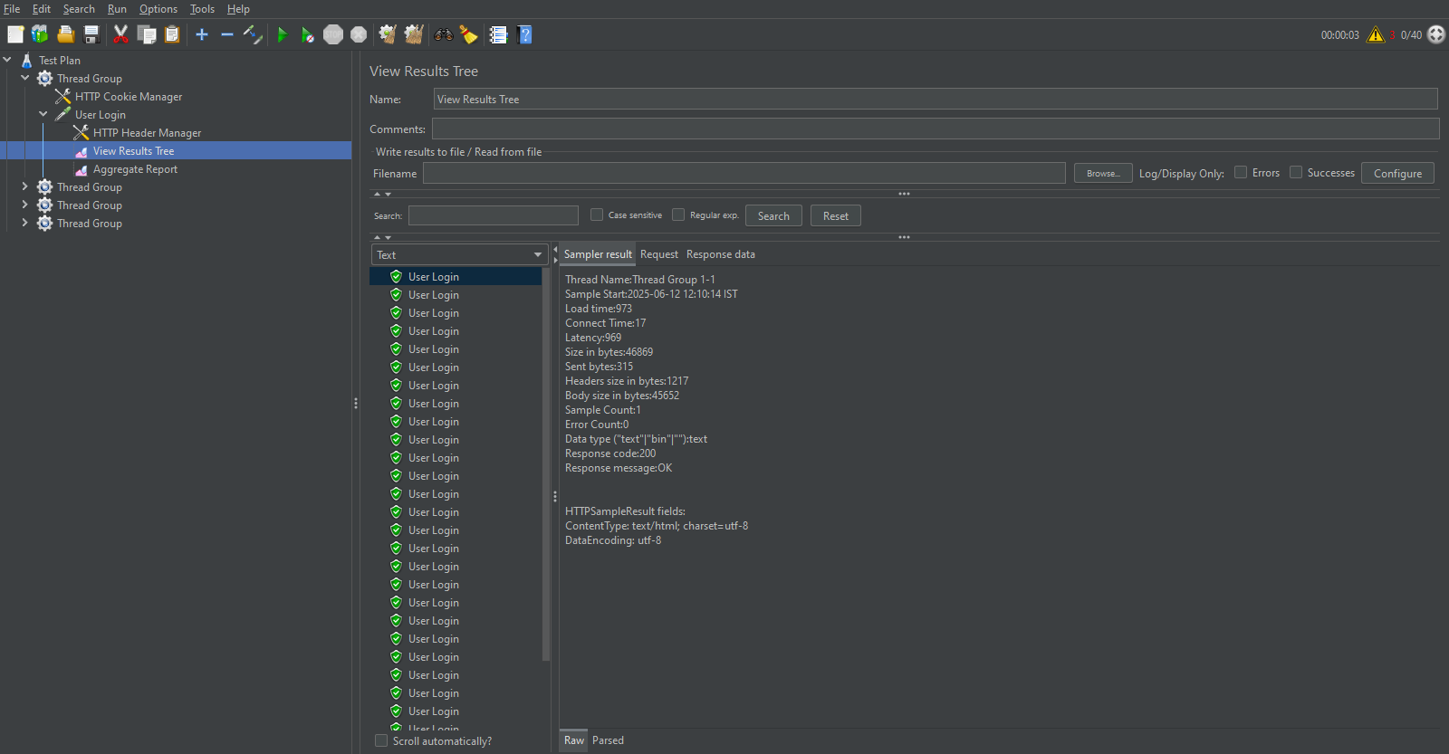
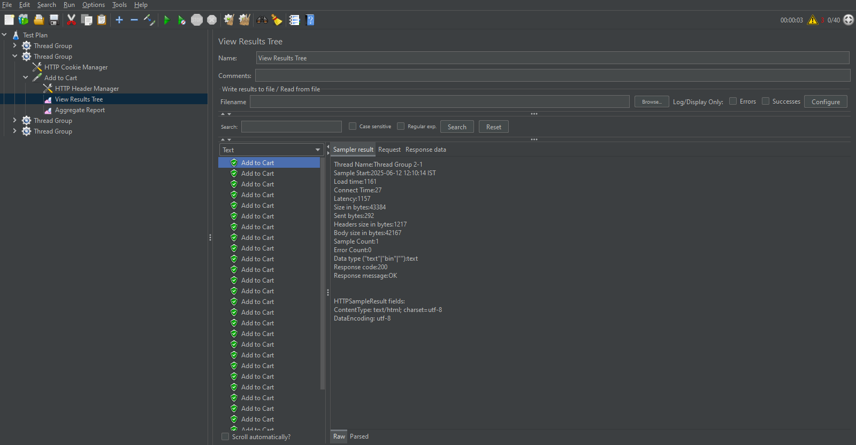
AUTOMATION TEST REPORTS
JMETER FOR TESTING
Fig. Login page and add to cart page

Slide 14
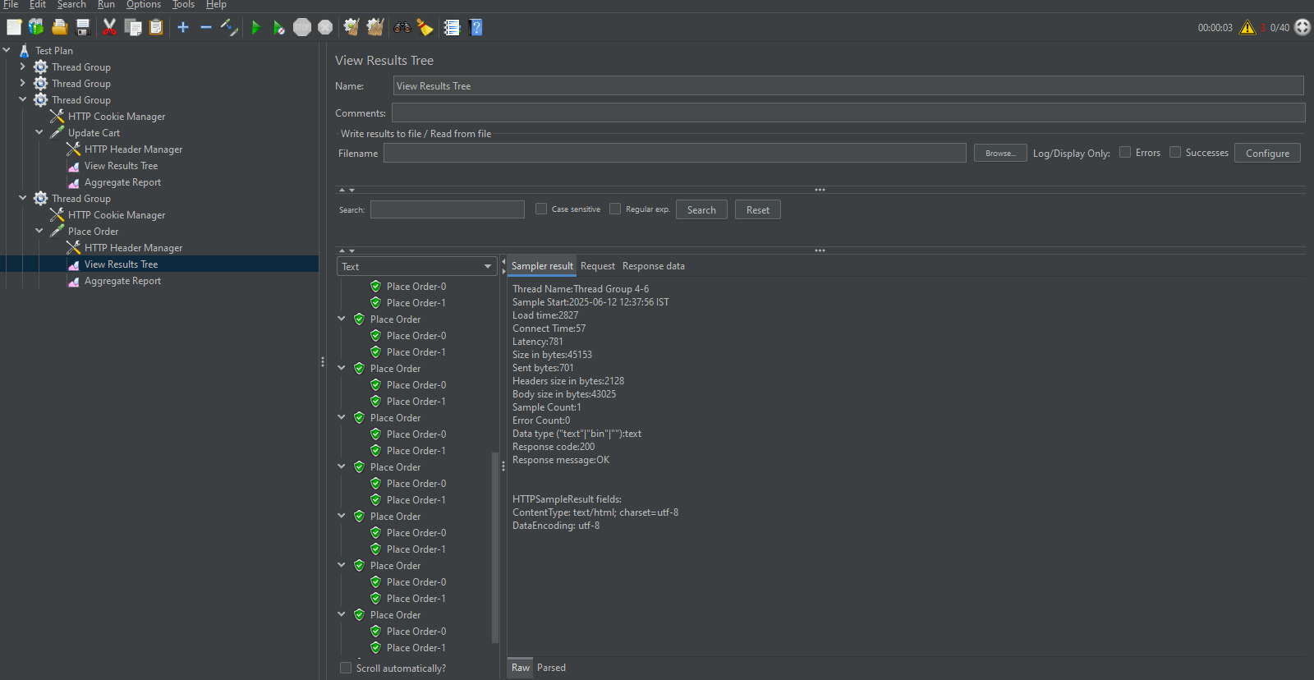
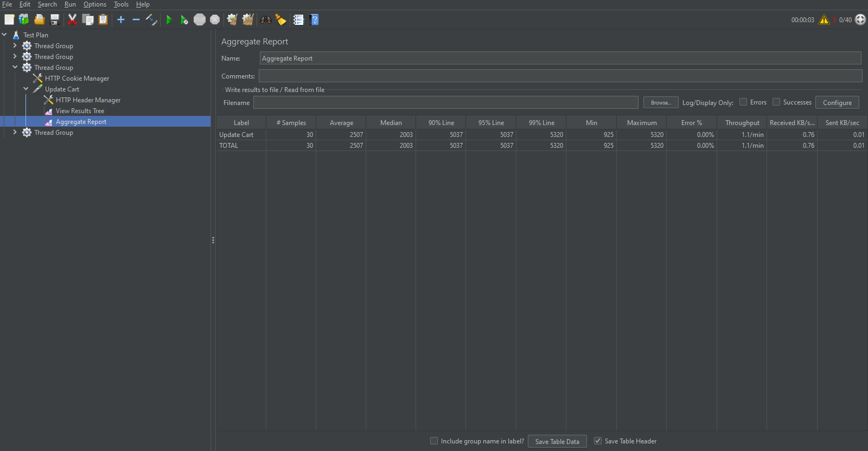
AUTOMATION TEST REPORTS
JMETER FOR TESTING
Fig. placing order page and final reporting page

Slide 15
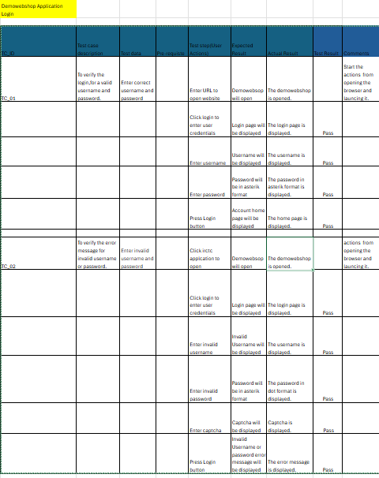
MANUAL TESTING
TEST CASE WRITING
Fig. Test Case Description for Login

Slide 16
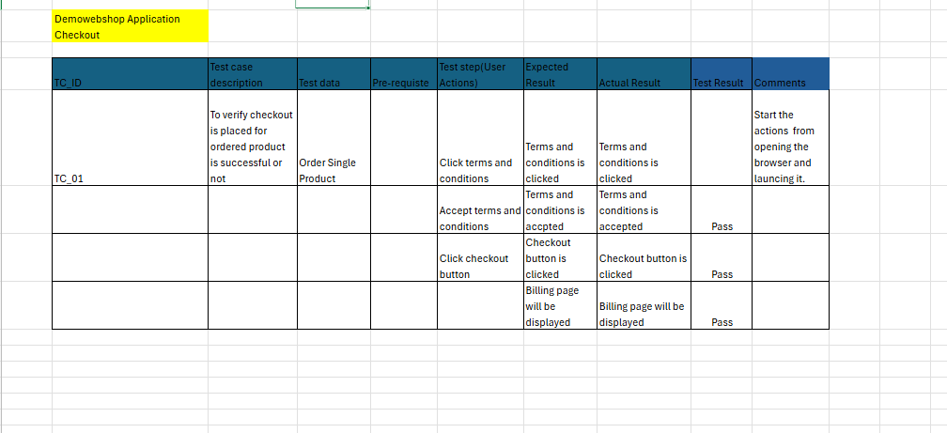
MANUAL TESTING
TEST CASE WRITING
Fig. Test Case Description for Checkout

Slide 17

THANK YOU

